Slide 1
“Delay & Speedy Trial in the realm of Juvenile Justice ? ”
-by Adv.Sneha Singh (Child Rights Lawyer)

Slide 2
Which delay we are taking about ?

Slide 3

The word ‘Delay’ has been used 7 times in JJ
Sec. 9 Production of Juvenile before a Magistrate who is not empowered under JJ act -without any delay forward to JJB with recorded opinion.
Sec.36 Inquiry of CNCP -pendency at CWC - delay in constitution of a new CWC, then CWC of a nearby district shall resume responsibility in the intervening period - for addressing pendency .

Slide 4
Sec.42 Penalty for non-registration of CCI- delay of each 30 days will treated as a separate offence .
Rule. 8 (3) - Apprehended child shall be forwarded to CWPO/SJPU by the police officer -“not delay it”.
Rule.34 (3) (x) Waiver of consent of parents/guardian for Medical Care - Child In CCI- surgical intervention without the previous consent of parents ,if can’t be contacted & delay will cause unnecessary suffering or injury to the health of child or danger to his life.

Slide 5
Rule.69 (A) (2) Institutional management of children - In case of doubt about the identity of a child - Receiving officer-forthwith-report this to Person-in-Charge- who without any delay inform the Board/Committee and produces the child.
Rule.75 (1) (5) -Child dies within 30 days of his admission in CCI- Reporting by Person-in-charge to Police/District Medical Officer/Nearest Govt. Hospital/Parents;Guardians;Relatives- without delay.

Slide 6
Why the delay ?

Slide 7
Factors causing delay in JJ
Technical (offence related)
Procedural impediments
Infrastructure
Child Rehabilitation
Stakeholder ’s incompetence

Slide 8
“Shifting the narrative from criminality to delinquency”
Delinquency as its core
Identifying the delinquency & addressing it
Criminality has never been the premise of JJ system
Petty Offence (Summary Proceedings) / Serious & Heinous before JJB - Trial in Summons Case
Rule.10 (7) -Witnesses for examination-not strict adversarial + presumption in favour of child

Slide 9
How Much Delay Is Denial Of Justice in JJ System ?

Slide 10
Case Study#1 (Child Victim of Sexual Abuse)
A 12 yrs old child brutally raped at the midnight in a dense forest by the perpetrator and was left alone in the forest .
After being rescued she only give her statement once during 164 in the hospital and then shuts herself up .
She has been undergoing counselling for past 1 year but she is till mum when it comes to the court.
The trial at the POCSO Court gets hampered everyday ; how will you secure a speedy trial in this scenario ?

Slide 11
Case Study#2 - CCL in a NDPS Case
X, a child of 16.5 years has been brought by the police to JJB under section. 27 (Punishment for consumption of any narcotic drug or psychotropic substance )
It was a petty offence , on the day of first production X was released on an undertaking of his parents to appear before JJB on each date.
Two months have passed no PIR has been filed in the matter
Case was disposed as the proceedings got terminated.

Slide 12
Case Study#3 (CCL & Plead of Guilt)
K ,a 17.5 yrs old child- has been alleged to be involved with the stealing of motorbikes in his area.
Brought before the JJB by the police on the same allegations; wherein K ,shares that he is compelled to do so since a goon in his locality threatens him at the cost of his family’s safety.
JJB releases the child after advise & admonition ,there & then.

Slide 13
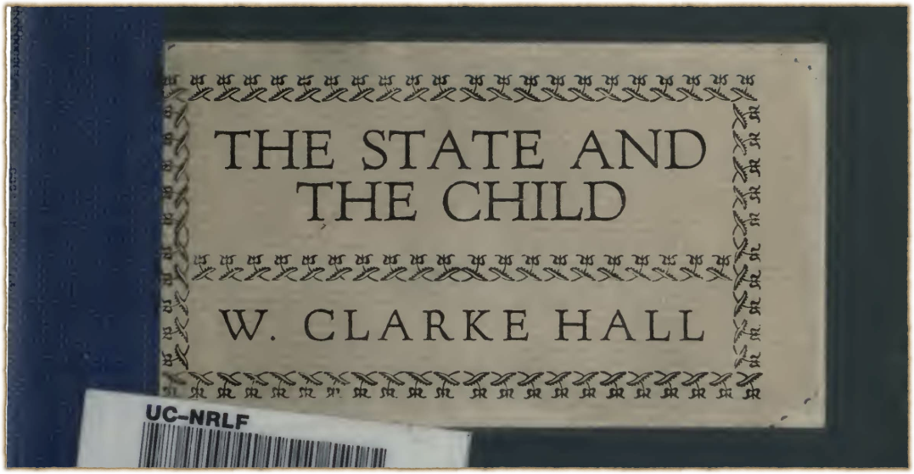
Thanks !
Adv.Sneha Singh ; Contact : +91 9871965469 ;
Email Id - advo.snehasingh@gmail.com

